Slide 1
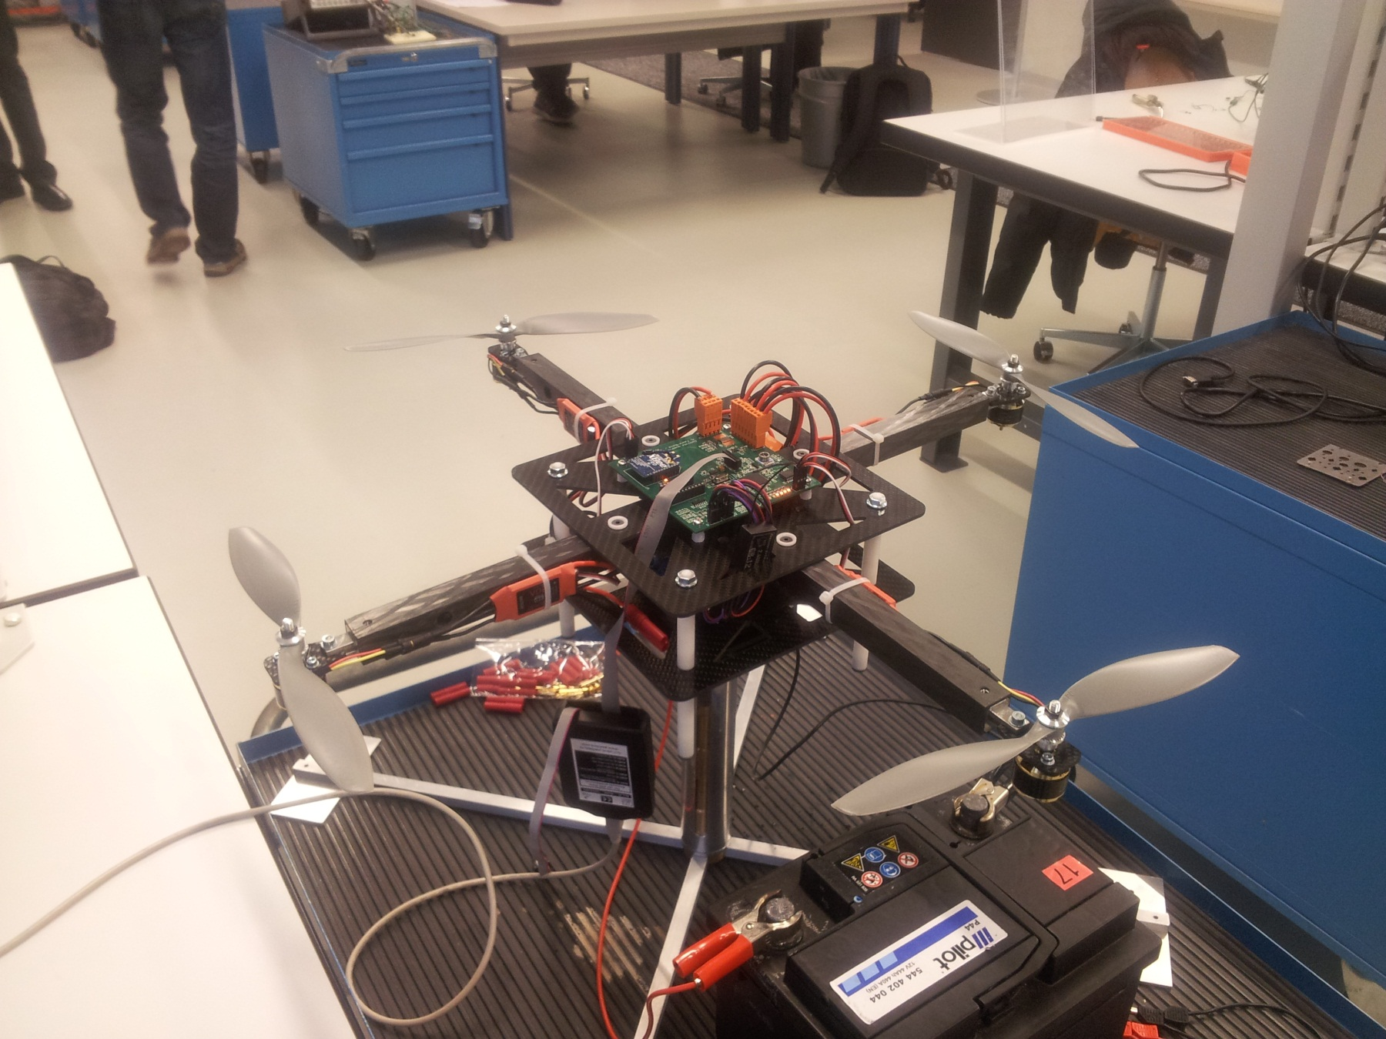
y accel
1
x accel
4
2
z gyro
y gyro
3
x gyro
z accel

